Slide 1
Optimized Binary Search Tree Implementation: Performance, Memory Efficiency, and Scalability for Large Datasets
Rinku Gopali

Slide 2
Project Overview:
Educational tools for algorithm learning
Sorting algorithms visualizer
Binary search tree implementation
Focus on performance optimization

Slide 3
Sorting Algorithms Visualizer:
Web-based application using Streamlit
Interactive interface for algorithm selection
Real-time visualization of sorting process
Supports multiple sorting algorithms (Ruzankin, 2022)

Slide 4
Binary Search Tree Implementation:
Efficient data structure for large datasets
Self-balancing techniques (AVL Tree)
Memoization for frequently accessed elements
Lazy deletion for memory efficiency

Slide 5
Educational Value:
Visual representation of algorithm behavior
Hands-on learning experience
Comparison of different sorting techniques
Understanding of data structure optimization

Slide 6
Performance Challenges:
Handling large datasets efficiently
Visualization slowdowns with complex algorithms
Memory management for extensive operations
Scalability issues with increasing data size

Slide 7
Optimization Techniques:
Implementation of AVL tree for self-balancing
Memorization to speed up repeated searches
Efficient memory management strategies
Lazy deletion to improve overall throughput

Slide 8
Scaling Strategies:
Efficient insertion techniques for large datasets
Memory optimization for millions of elements
Batch insertion for improved performance
Balanced tree structure maintenance (Nematzadeh et al., 2020)

Slide 9
Testing and Validation:
Advanced testing scenarios for edge cases
Stress testing with large datasets
Performance analysis of optimized implementation
Comparison with initial, unoptimized version

Slide 10
Visualization Challenges:
Managing real-time updates effectively
Representing large arrays clearly
Ensuring algorithm process clarity
Maintaining educational effectiveness at scale

Slide 11
Memory Management:
Explicit handling of node references
Optimization of garbage collection processes
Monitoring of peak memory usage
Efficient allocation and deallocation of resources

Slide 12
Future Improvements:
Integration of advanced sorting algorithms
Development of alternative visualization techniques
Exploration of distributed data structures
Incorporation of machine learning for optimization

Slide 13
Implementation Trade-offs:
Balancing performance overhead with optimization benefits (Pappula, 2022)
Managing memory usage versus speed improvements
Considering throughput against immediate memory reclamation
Evaluating complexity increase for performance gains

Slide 14
Project Outcomes:
Enhanced understanding of fundamental algorithms
Optimized data structures for real-world use
Scalable solutions for large dataset management
Practical tools for both education and industry applications

Slide 15
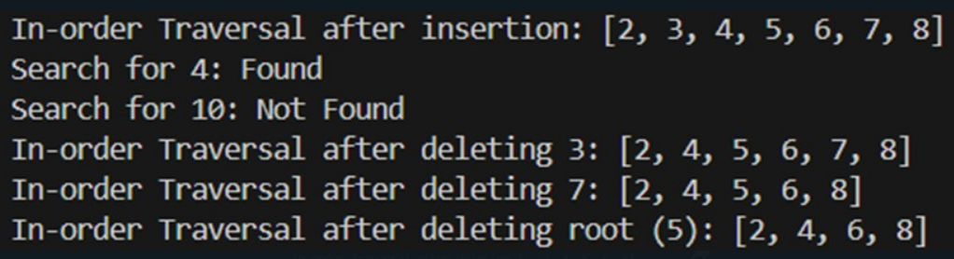
Phase 2 output:

Slide 16
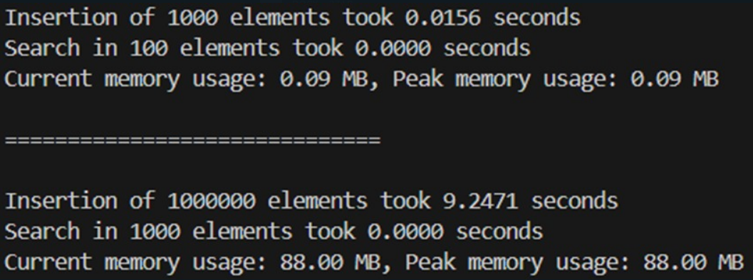
Phase 3 output:

Slide 17
References
Pappula, P. (2022). A Novel Binary Search Tree Method to Find an Item Using Scaling. Int. Arab J. Inf. Technol., 19(5), 713-720. https://www.researchgate.net/publication/362696990_A_Novel_Binary_Search_Tree_Method_to_Find_an_Item_Using_Scaling
Nematzadeh, H., Enayatifar, R., Yadollahi, M., Lee, M., & Jeong, G. (2020). Binary search tree image encryption with DNA. Optik, 202, 163505. https://www.sciencedirect.com/science/article/abs/pii/S0030402619314032
Ruzankin, P. S. (2022). A Fast Parallelizable Algorithm for Constructing Balanced Binary Search Trees. SN Computer Science, 3(5), 367. https://arxiv.org/pdf/1902.02499

Slide 18
Thank You!

